Slide 1
Advanced Phishing URL Detection System using Machine Learning and Neural Networks
Raduan Ahamed
ID : 221-15-4977
Department of CSE
Daffodil International University
Ms Rabeya Khatun
Lecturer
Department Of CSE
Daffodil International University

Slide 2
Outline
Introduction
Problem Statement
Motivation and Objective
Related Works
Comparison Between Existing Works
Gap Analysis
Proposed Methodology
Q & A

Slide 3
Introduction
Phishing attacks are among the most common and damaging cybersecurity threats, tricking users into revealing sensitive information through deceptive URLs. Traditional detection systems, often based on blacklists or basic machine learning models, struggle to identify newly generated or highly obfuscated phishing links, resulting in high false positives and missed detections.
To address these challenges, this research explores both traditional machine learning algorithms (Naive Bayes, SVM, CNN) and advanced neural network models (BERT, XLNet, Seq2Seq) for phishing URL detection. The study uses a balanced dataset from the UCI Irvine Machine Learning Repository, applies preprocessing to remove duplicates, and extracts lexical, domain-based, and keyword-based features. Models are trained with an 80–20 split, k-fold cross-validation, and hyperparameter tuning, with performance evaluated using accuracy, precision, recall, and F1-score.
The best-performing model from this study will be integrated into “PhishCheck”, a web-based AI tool for real-time phishing URL analysis. This approach not only contributes to academic research but also provides a practical, scalable solution to protect users against evolving phishing threats.

Slide 4
Problem Statement
Existing phishing detection systems fail to keep up with new and obfuscated phishing URLs.
Lack of real-time detection and adaptive intelligence in traditional models.
High false positives/negatives in current systems.
Need for an AI-driven system capable of learning and evolving with phishing techniques.

Slide 5
Motivation and Objective
Motivation:
Protect internet users from sophisticated phishing attacks.
Use advanced AI models (BERT, XLNet) for improved prediction.
Build a web-based tool for real-time URL analysis.
Objectives:
Collect and preprocess a labeled phishing URL dataset.
Extract effective lexical, domain, and keyword-based features.
Train and evaluate traditional ML and neural network models.
Deploy a smart AI-based phishing URL checker tool.

Slide 6
Related Works
Rule-Based Detection (Blacklist/Whitelist)
Simple matching of URLs against a known list.
Fast but fails to detect newly generated phishing URLs.
Machine Learning Approaches
SVM, Random Forest, Naive Bayes with lexical features (URL length, character counts).
Achieved 80–88% accuracy but struggled with obfuscated URLs.
Deep Learning Models
CNN and LSTM applied to character-level and token-level URL sequences.
Better at pattern recognition but still lacked semantic understanding.
Achieved 80–88% accuracy but struggled with small dataset.
Transformer-Based Models
BERT and XLNet used for phishing detection in limited studies.
Showed improved recall and robustness against unseen phishing attacks.
Achieved 80–88% accuracy but struggled with small dataset.

Slide 7
Comparison Between Existing Works
Approach | Technique Used | Accuracy Range | Limitations
Rule- Based | Blacklist / Whitelist | 70–75% | Cannot detect new URLs
Traditional ML | SVM, Random Forest | 80–88% | Limited to lexical features
Deep Learning (RNN/CNN) | Sequence/Character-level | 85–90% | Needs large datasets, still lacks semantic context
Transformer Models | BERT, XLNet | 92–95% | High computational cost, few phishing-specific studies
My Proposed System :
Feature | Existing System | Proposed system
Live URLs | ❌ | ✅
Multiple AI/ NN Model | 1 or 2 Model used | NB, SVM, CNN,BERT, LSTM, Seq2Seq, XLNet
Large Dataset | Up to 11000 Data | Over 250,000 data with both phishing and valid urls

Slide 8
Gap Analysis
Many models are limited to lexical or syntactic patterns only.
Few consider semantic context (e.g., BERT, XLNet), which is essential in modern phishing.
Lack of comprehensive systems combining:
Lexical + Domain + Keyword-based features
Traditional ML + Neural Networks
User-accessible web tool
Only few model used
Our work aims to fill this gap by combining these layers into one unified AI-driven detection system.

Slide 9
Proposed Methodology
The first step involves collecting a dataset from the UCI Irvine Machine Learning Repository, ensuring a balanced mix of phishing and legitimate URLs. This is followed by data preprocessing, where duplicates URLs are removed, and necessary transformations are applied to prepare the data for feature extraction.
Feature extraction is a crucial step where various characteristics of URLs are analyzed. Lexical features, such as URL length and special character occurrences, domain-based features like WHOIS information and DNS records, and keyword-based features including suspicious words commonly found in phishing URLs, are extracted to aid in classification. These extracted features are then used to train multiple machine learning models, including Naive Bayes, XLNet, Seq2Seq, BERT, CNN, and SVM.
The models are trained using an 80-20 train-test split, with k-fold cross-validation employed to enhance generalization and robustness. Hyperparameter tuning is performed to optimize the models for accuracy. Each model is evaluated using various performance metrics, including accuracy, precision, recall, F1-score, and the ROC curve to determine their effectiveness in distinguishing phishing URLs from legitimate ones.
The final phase of implementation involves testing the trained models on the dataset and evaluating their effectiveness. This approach ensures a scalable and adaptive phishing detection system that evolves with emerging cybersecurity threats.
Also Want to make a Web based tool for URL checking With AI

Slide 10
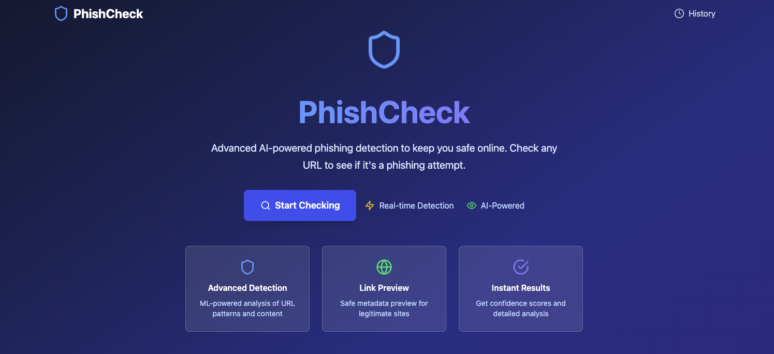
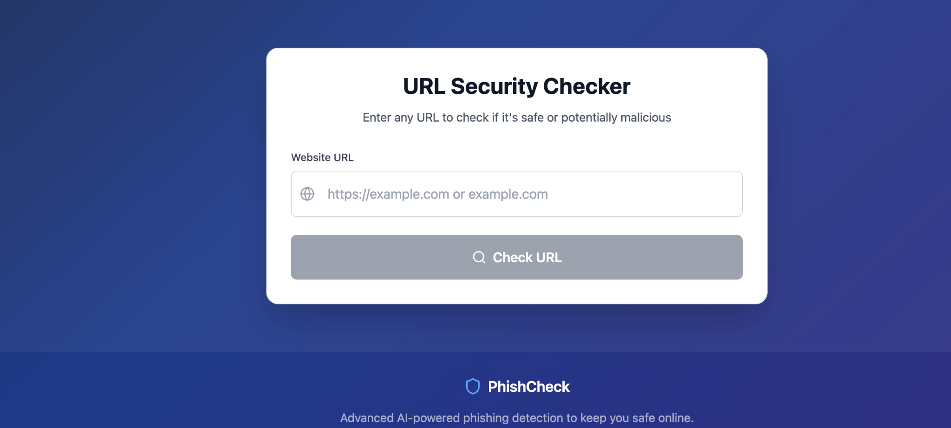
Web Tool
A prototype of website/ web tool for URL checking With AI. I already built primarily after completing the model training, I would add the model in the website backend

Slide 11
THANK YOU

